Slide 1
Effects of Quantization
  Floating point vs. fixed point
  Analysis of effects of quantization on parameters
  Analysis of effects of quantization on signals
    Worst case
    Steady-state worst case
    Example

Slide 2


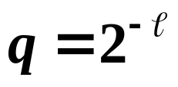

Effects of Quantization
When a digital computer is used for controlling a plant,
the control u(k) can:
  1. Only change at discrete times
  2. Only be represented to finite accuracy
Quantization:
Required by digital microprocessor
A/D
where is the number of bits

Slide 3
Floating Point vs. Fixed Point
Floating point
Advantage: more flexible, more accurate
Disadvantage: slower, more difficult, more costly
Fixed point
Advantage: economical, faster, easier
Disadvantage: less flexible, underflow and overflow, less accurate, scaling needed.

Slide 4
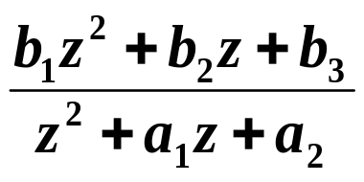


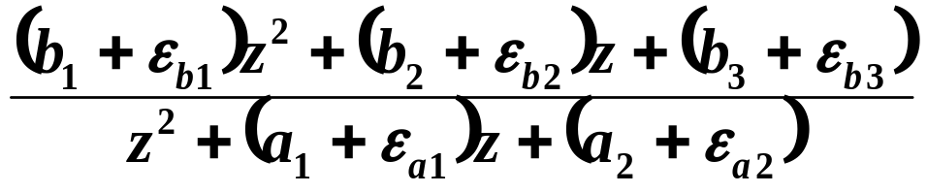
Recommended Implementation Architectures
Brief discussion of quantization of parameters :

Slide 5
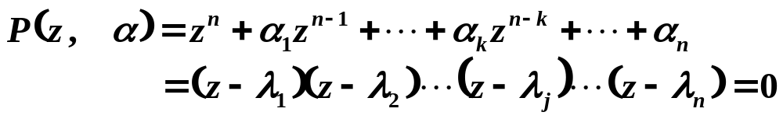

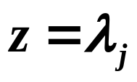
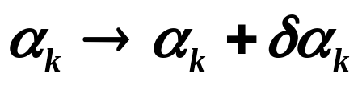
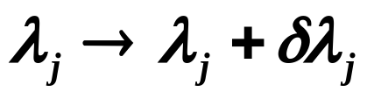
Effect of Parameter Storage Errors
In general, characteristic equation:
When there are no word length limitations in storing
the coefficients , the nominal roots are .
Suppose there is an error in a coefficient:
This causes an error in the poles:
Stability can be affected!

Slide 6
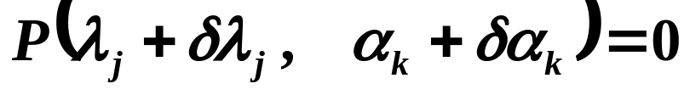
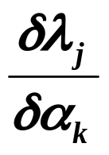
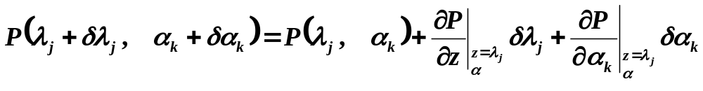

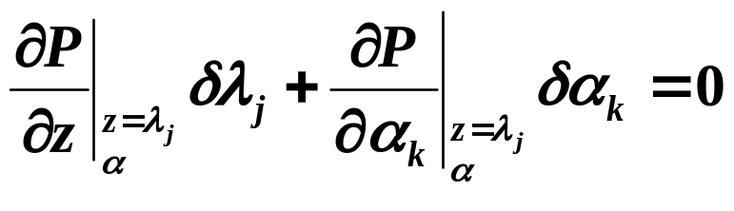
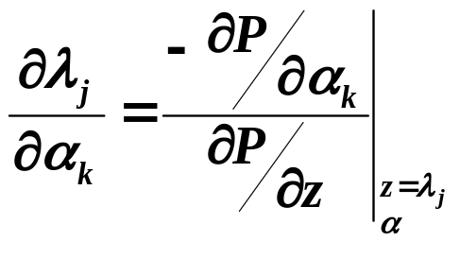
Calculate sensitivity:
Sensitivity:

Slide 7
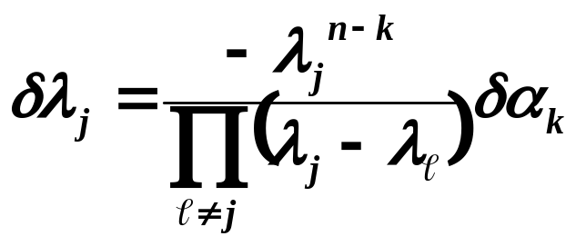
Sensitivity for direct realization:
All poles are assumed to be distinct. If any roots have multiplicities greater than 1, then the sensitivities of these roots are infinite.
Pole locations are especially sensitive to parameter changes/errors if poles are close.
In direct realization, the sensitivity to parameter storage errors are higher than parallel or cascade realization.

Slide 8
Example:
This brief analysis indicates that the best way (i.e., least sensitive to quantization of parameters) to implement a higher-order controller is to break it down into first and second-order components and use either a cascade or parallel implementation.
A 6th-order system with 2 pairs of complex poles and 2 real poles can be implemented with a cascade of lower-order factors:
2nd-order
2nd-order
1st-order
1st-order

Slide 9

Or, in a parallel implementation:
2nd-order
2nd-order
1st-order
1st-order
Using a direct realization or a direct implementation
of the 6th order controller can be significantly more sensitive to quantization of parameters:
6th-order

Slide 10
Now let’s analyze the effects of quantization on signals :

Slide 11
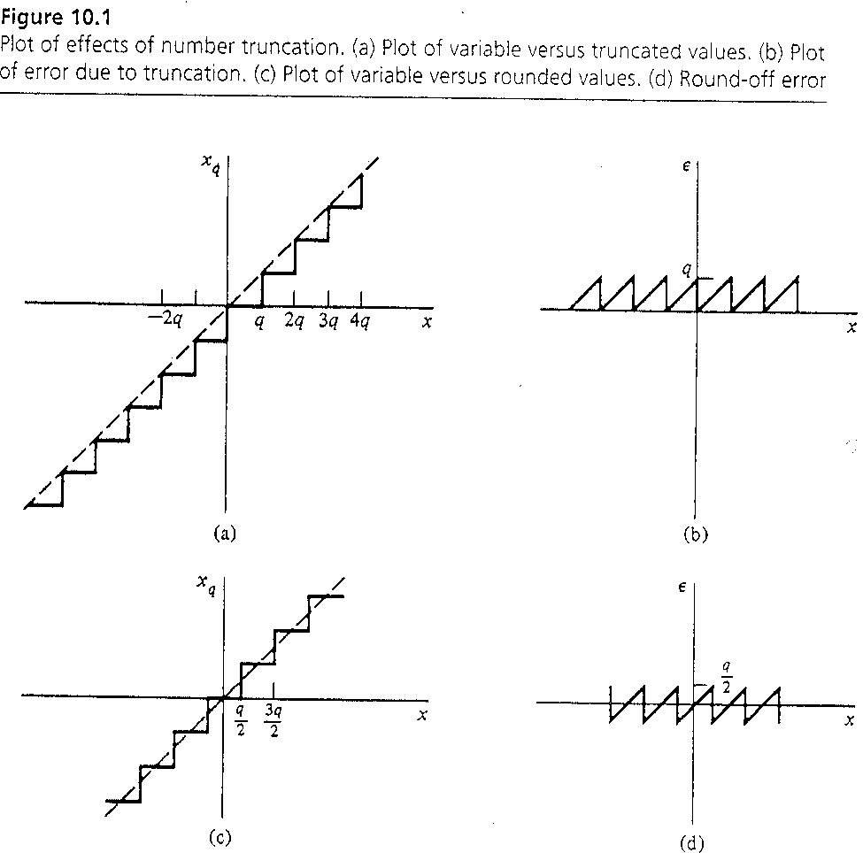
Effect of Quantization on Signals
Truncation:
Rounding:

Slide 12
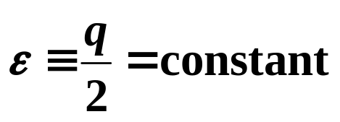
How Do We Represent ε ?
Difficult to do exactly because of the nonlinear nature of ε .
Assume fixed-point and round-off.
  Worst case (Bertram): ε is selected to make effect of error as large as possible.
  2. Steady-state worst case (Slaughter and Blackman): for round-off,

Slide 13




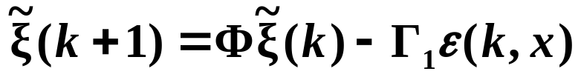

1. Worst Case
Ideally:
In reality:
Let:
Then:

Slide 14
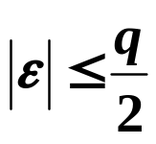

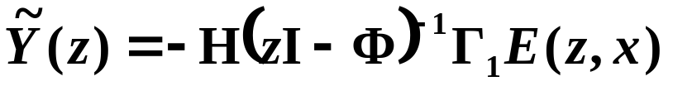
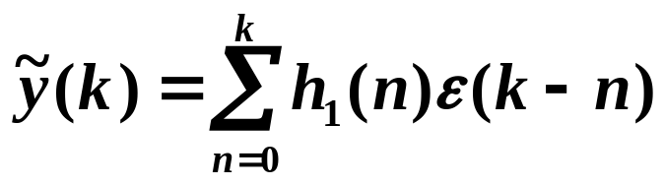

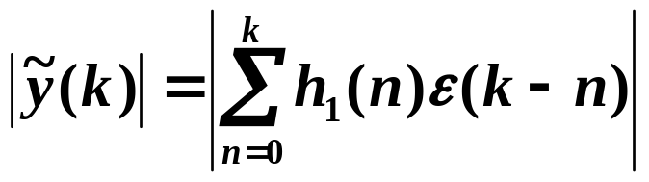
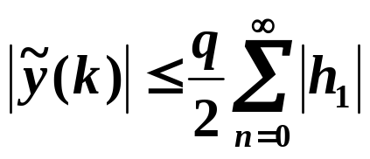
For round-off:
The transfer function from
Inverse Z-transform:
Assuming ε is selected so that is as large as
possible.
Worst case bound (pessimistic)

Slide 15
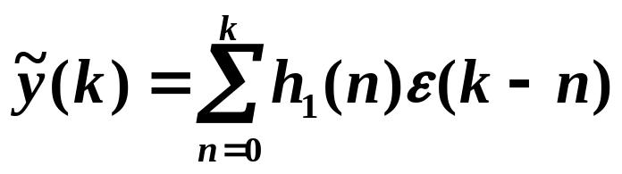
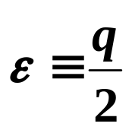
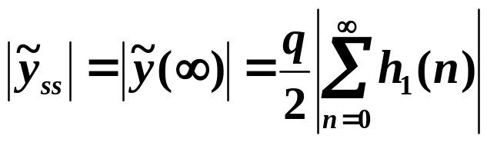
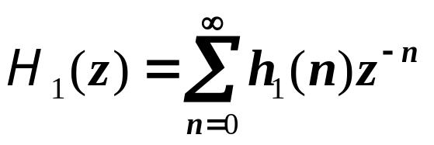
2. Steady-State Worst Case
Assume for all the time.

Slide 16
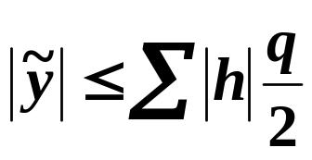
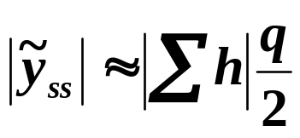
Comparison
Bertram’s Worst Case Bound:
Steady-State Worst Case:

Slide 17
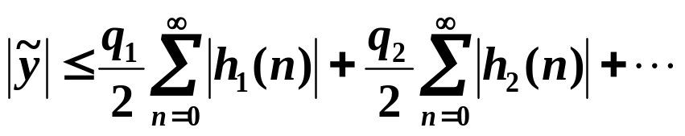
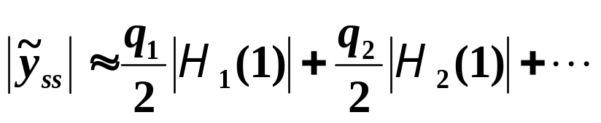
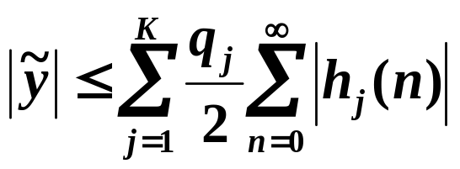
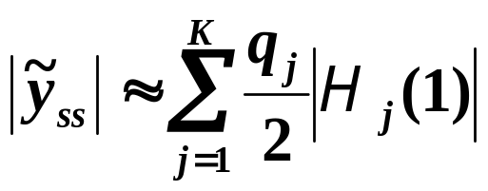
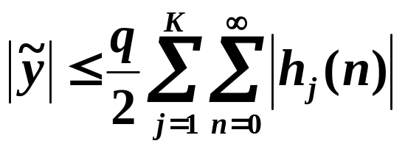
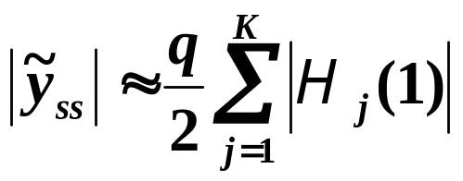
Generalization to Multiple Sources of Round-off Error
Bertram’s worst case:
Steady-state worst case:
If all q_{j}’s are equal:
If all q_{j}’s are equal:

Slide 18
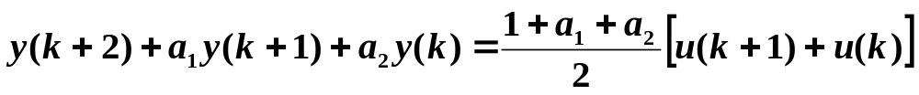
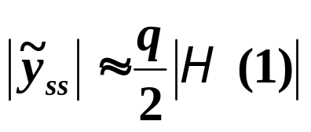
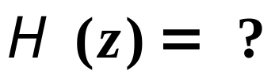
Example 10.4 of Text
Quantization Example
Second-order system:
Compute error at y using:
Worst-case bound
Steady-state estimate
2) Steady-state estimate
Assume quantization error ε enters at same
point where input u enters system.

Slide 19
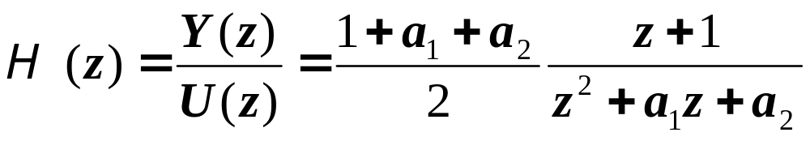
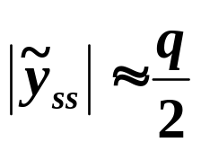
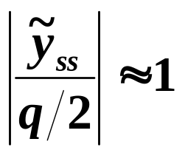
Normalized error:

Slide 20
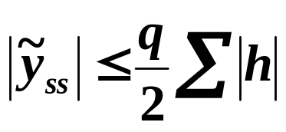
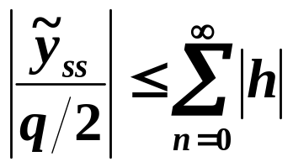
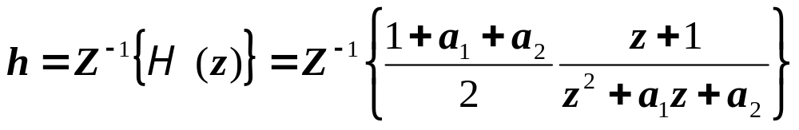

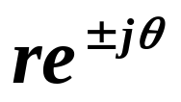
1) Worst-case bound
Normalized:
What is h ?
For
poles at
Using Z-transform table:

Slide 21
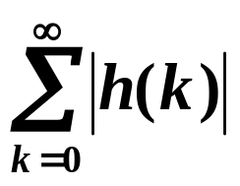
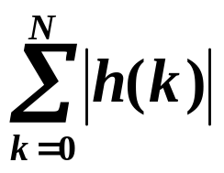
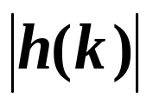
It is difficult to compute analytically, but it is
easy to write a script in Matlab to compute
where N is such that is “small”.

Slide 22
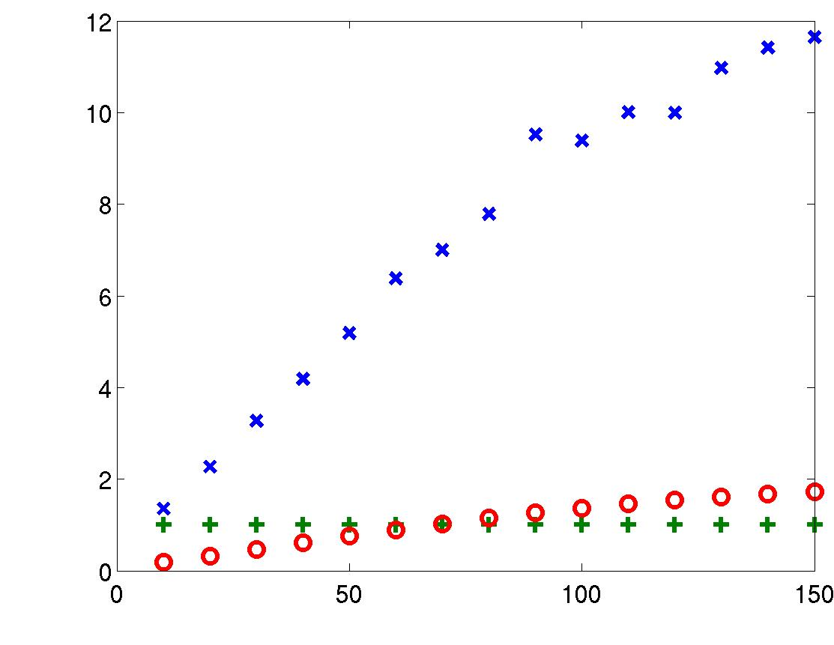
x x worst-case bound
+ + steady state
o o RMS estimate
poles at
∼
r = 0.9
Im(z)
Normalized quantization error, |y|/q/2
Re(z)
1
θ (degrees)

Slide 23
Other Quantization Topics
Stochastic analysis of quantization error (Section 10.1)
Limit cycles and dither (Section 10.3)

